Slide 1
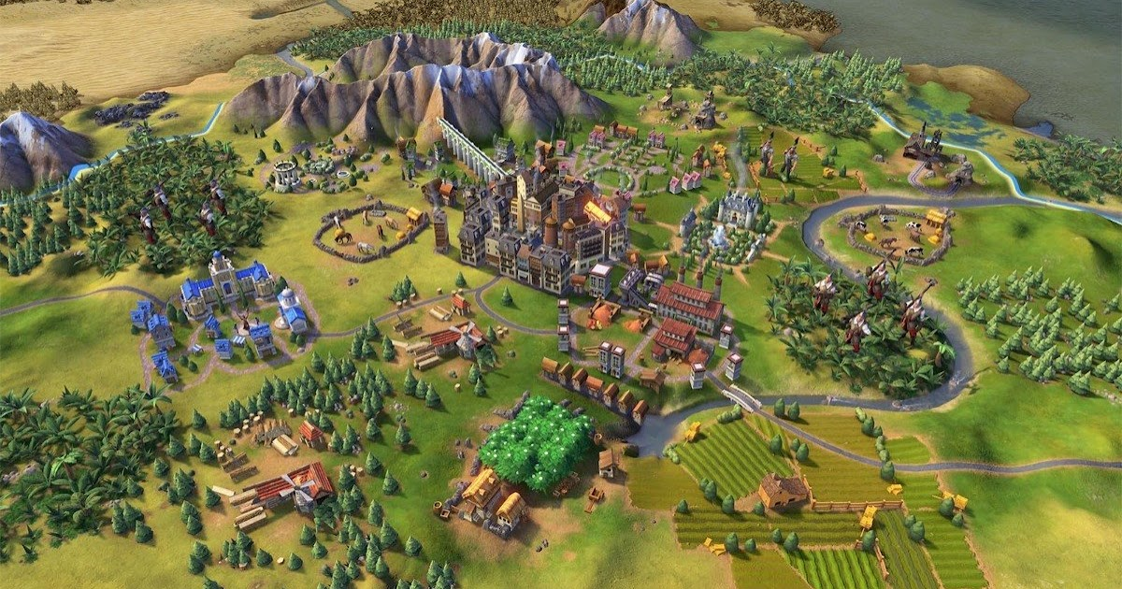
Project Evaluation
CIVILIZATION GAME

Slide 2
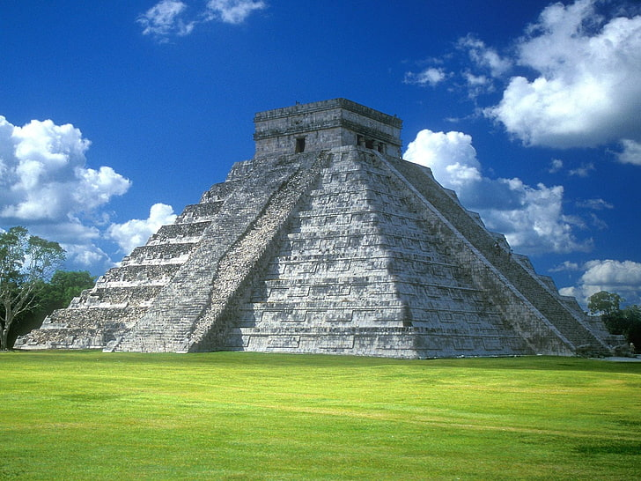
IDEA BEHIND THE PROJECT
The primary objective is to offer players a rich and immersive experience, combining historical context, strategic depth, and engaging gameplay. The game aims to challenge players to think strategically, adapt to changing circumstances, and leave a lasting mark on the simulated world.
In summary, the Civilization game project seeks to provide a comprehensive and dynamic strategy gaming experience, allowing players to shape the destiny of their civilization across the sweep of human history.

Slide 3
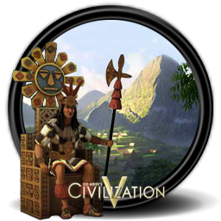
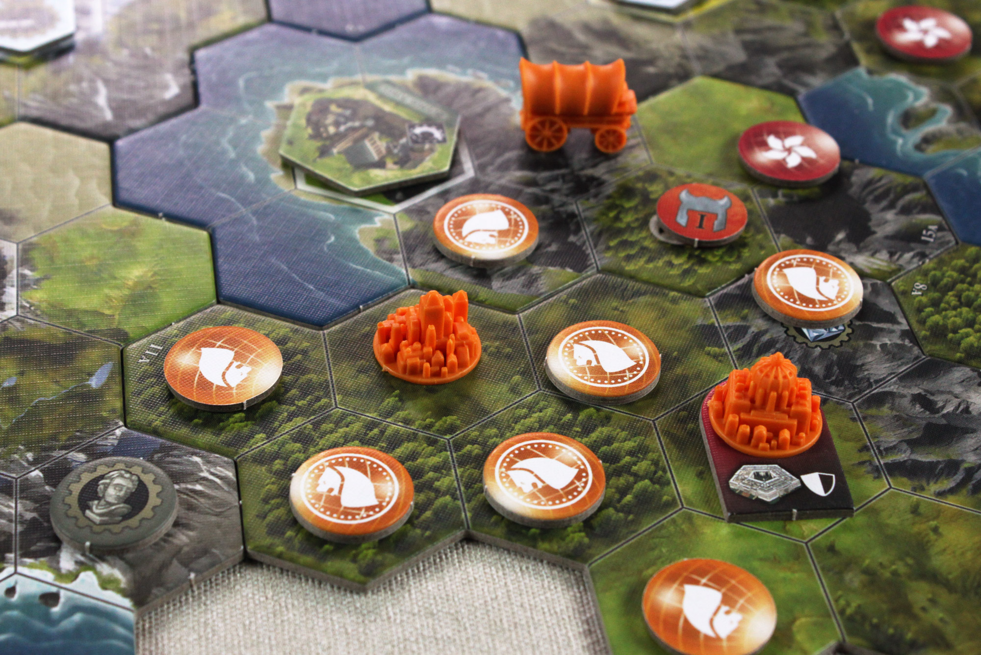
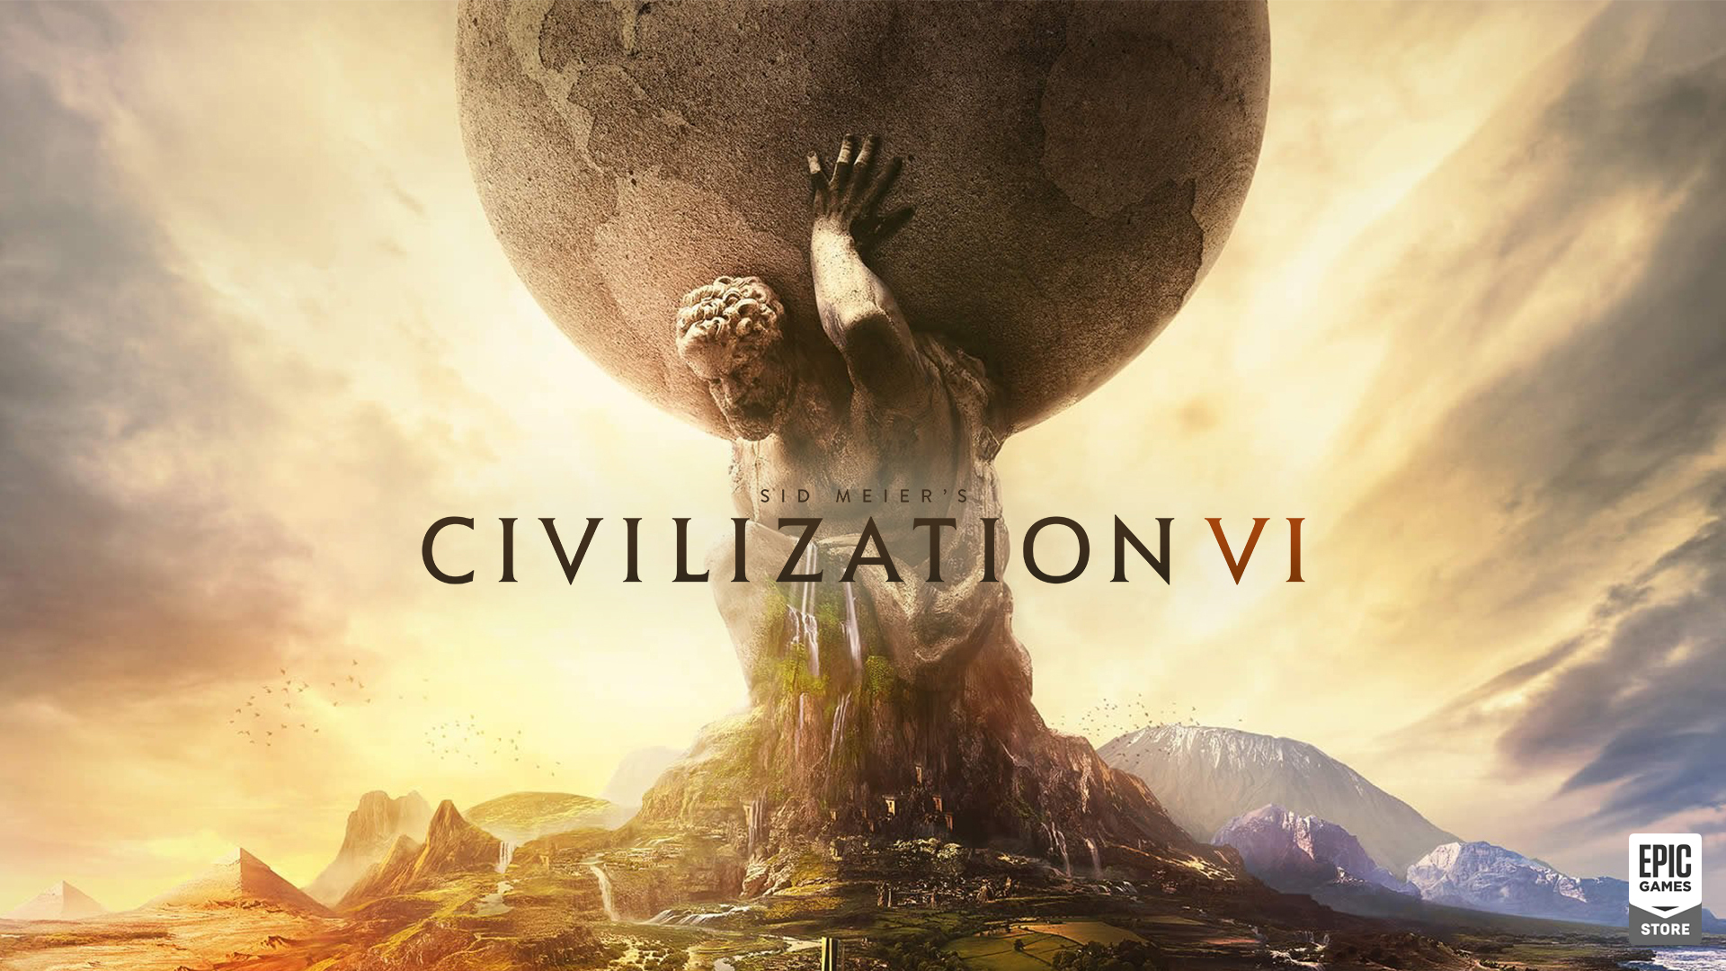
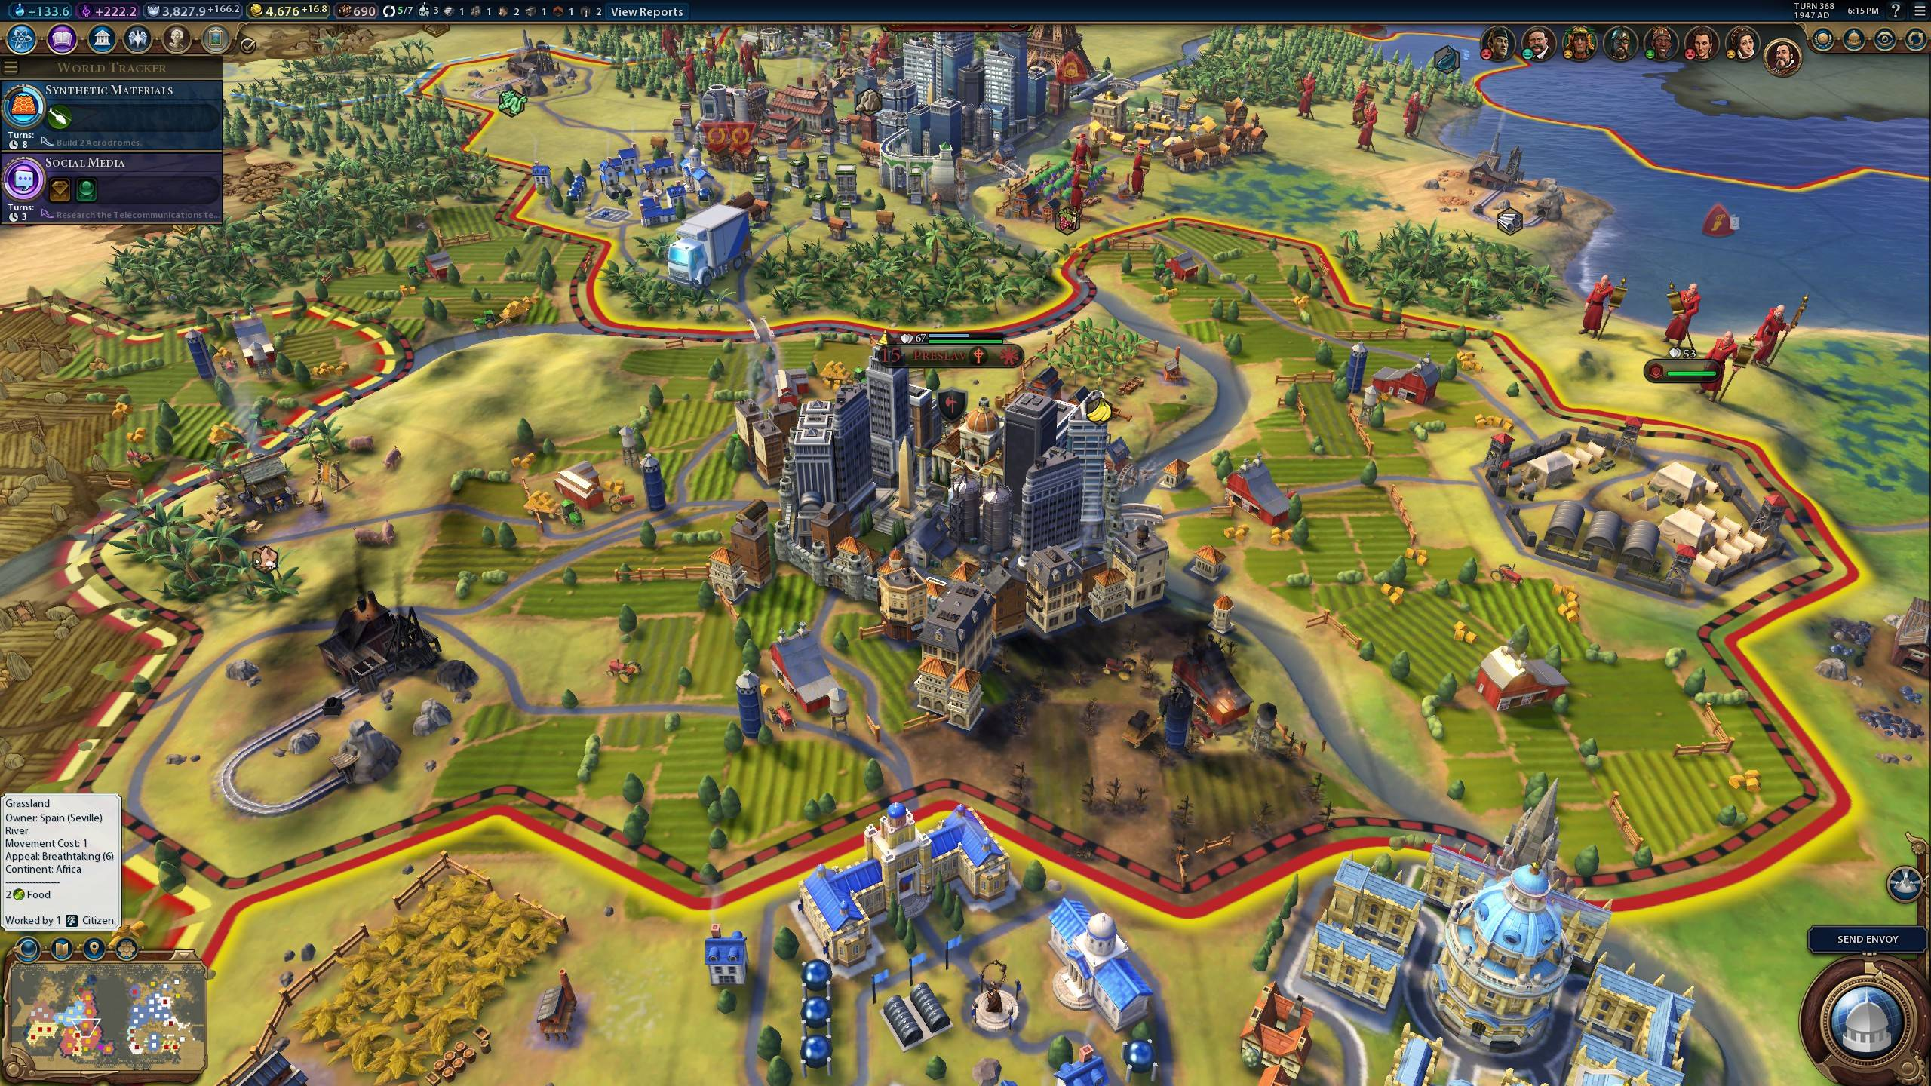
JAVA TECHNOLOGIES USED
AWT
SWING
JVM
JAVA THREADING
BASIC JAVA
This Photo by Unknown Author is licensed under CC BY-SA-NC
This Photo by Unknown Author is licensed under CC BY-NC-ND
This Photo by Unknown Author is licensed under CC BY-SA

Slide 4

TEAM DETAILS AND WORK DISTRIBUTION
ISHITA SHRIVASTAVA
Java Coding ​
​
As the Java coder, she has to handle the frontend and backend development, implementing the logic that powers our car racing game and also the gaming technologies which are:-
JVM
Java threading
​
TISHA KUSHWAH​
​
User Interface: Designing the overall look and feel of the game, making it pleasing and easy to navigate. While not a dedicated designer she ensures that the user interface is functional and user-friendly, collaborating closely with others.
​
Graphic Design: Takes on the role of a graphic designer, crafting visually appealing elements and assets which adds creative touch and will enhance the gaming experience.​
TANYA MISHRA
Tool Development: She focus on the development of the practical tool ensuring that they work seamlessly.
Basic Java: She will write the code to perform various tasks, implement algorithms, and solve problems.

Slide 5



